Slide 1
Fire Detection system
Team Members -
Saurabh Bhosale (09)
Pooja Gosavi (16)
Anurag Hajari (18)
Sayali Malgave (29)

Slide 2

Existing System
Most of the existing system consist of
water sprinkler and alarm system
There is no such facility of sending alert
notification to the users and Fire Stations,
which leds to the delay of Fire Brigades
to reach at the location

Slide 3
Proposed System
“Fire Detecting System” will help in detecting fire or smoke at an early stage and can
help in saving lives
We have designed a “Fire Detecting System” using temperature and smoke sensor which would
not only signal the presence of fire in a particular premise but will also send related information
through SMS
These systems do not require any human interaction
With the help of IoT and GSM module we can instantly send alert message to fire stations and
users

Slide 4
Scope and objective
The basic objectives of smart “Fire Detection System” is to protect human lives, material assets and the environment from danger effects of fire.
Personnel Protection - Preventing danger to life and health
Asset protection - Preventing material damage
Environment Protection - Preventing ecological damage

Slide 5
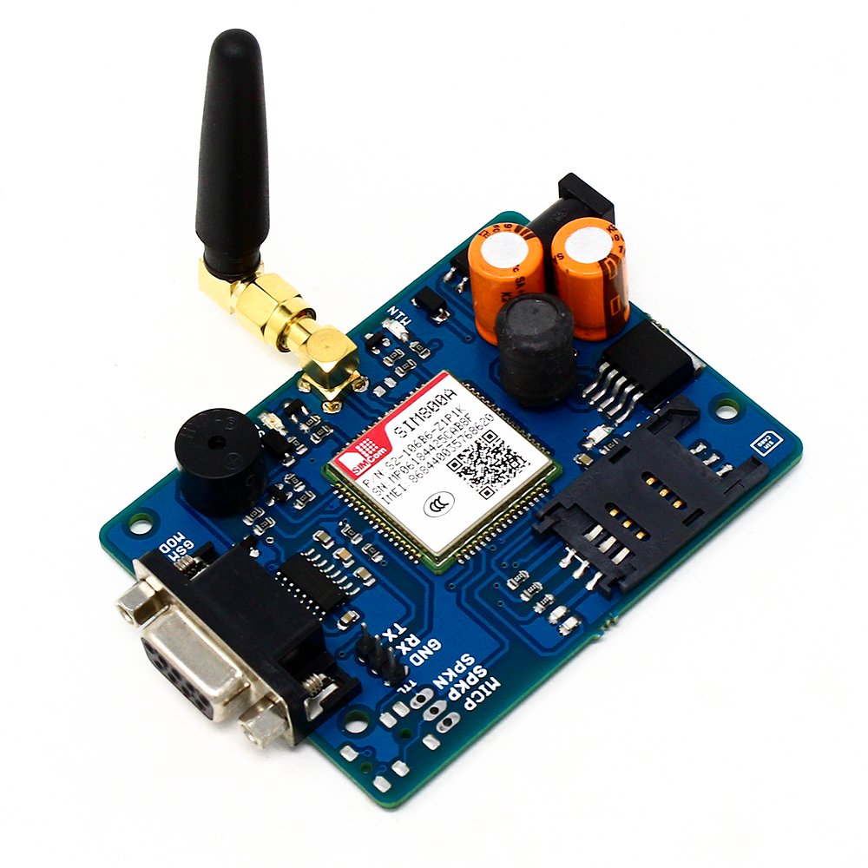

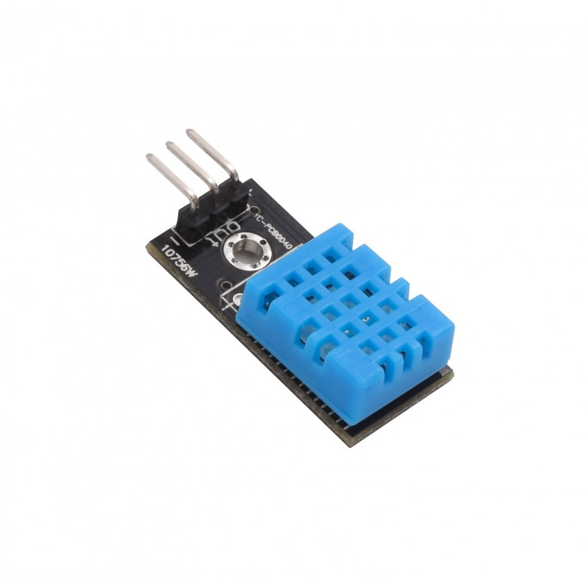
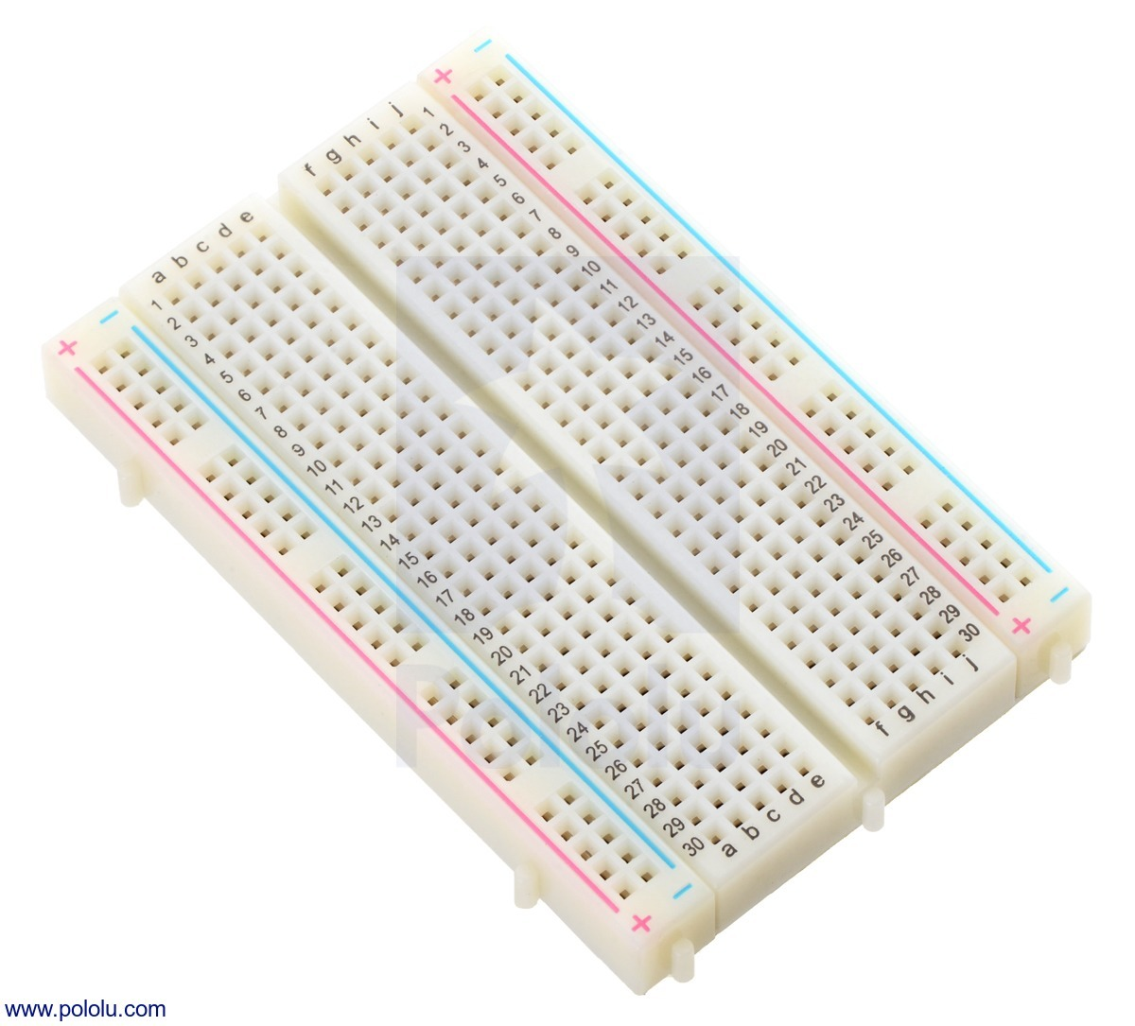
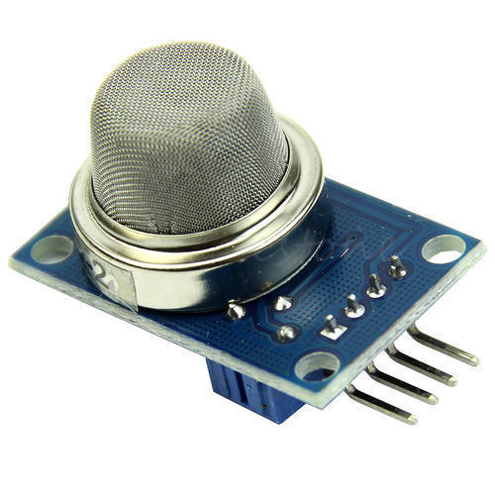
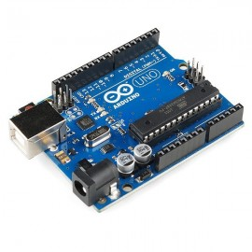
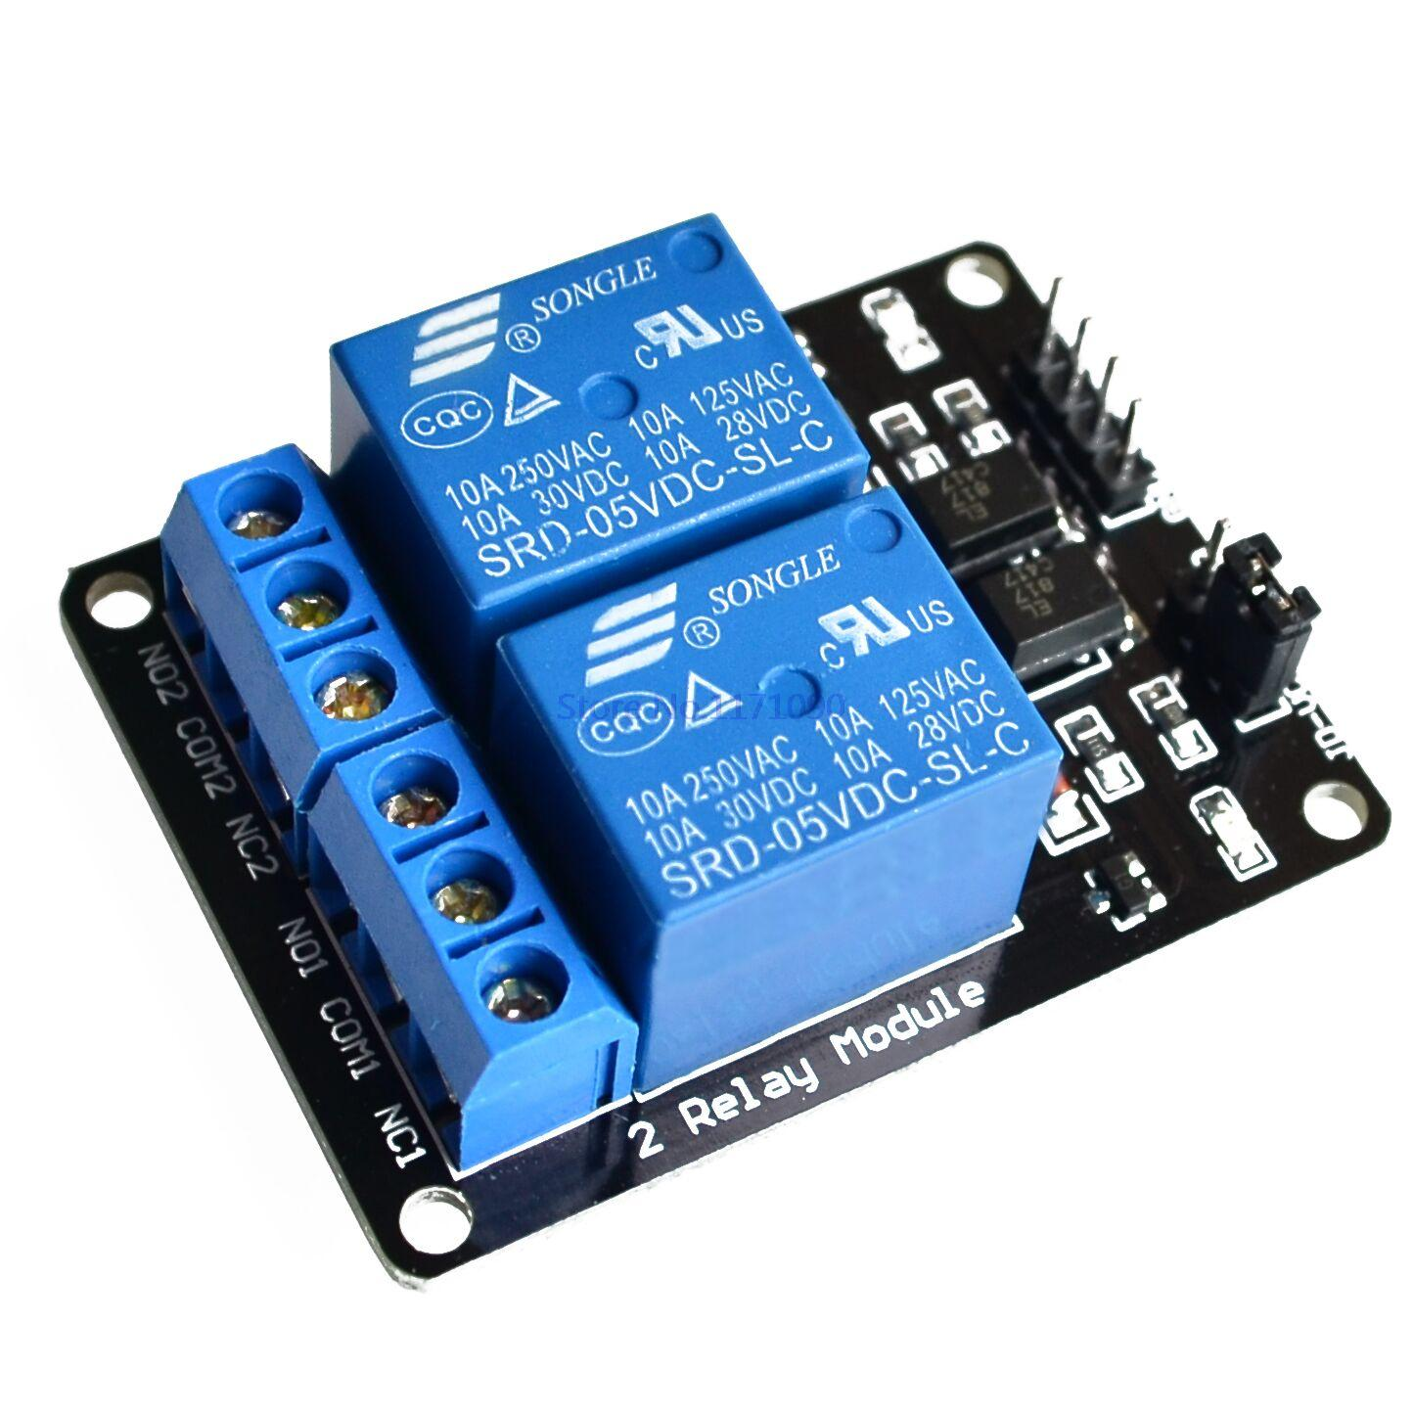
Components used
Microcontroller (Arduino UNO R3)
GSM Module (Sim 800A)
Smoke Sensor (Analog MQ2)
Temperature Sensor (DHT 11)
2 Channel Relay Module
DC Buzzer
LED Lights (Red, White)
DC Motor
Connecting Wires
Breadboard (Generic)
Adaptor

Slide 6
Flow of system
Fire occur in house
Module with multi-sensors
Water Sprinkler
SMS to Fire Station
GSM module
SMS to house owners

Slide 7
conclusion
The IoT technology improves the fire-fighting safety management work from traditional
fire-fighting to modern fire-fighting
We introduced an efficient technique to overcome the problems
We use multi-sensors for each regions to reduce misbehavior of system
The GSM communication system alerts the user at the very initial time of the fire
Early alert to fire department can reduce the impact and damage cause by fire

Slide 8
Thank you

